Slide 1

FloralFusion
Komal Nirania

Slide 2
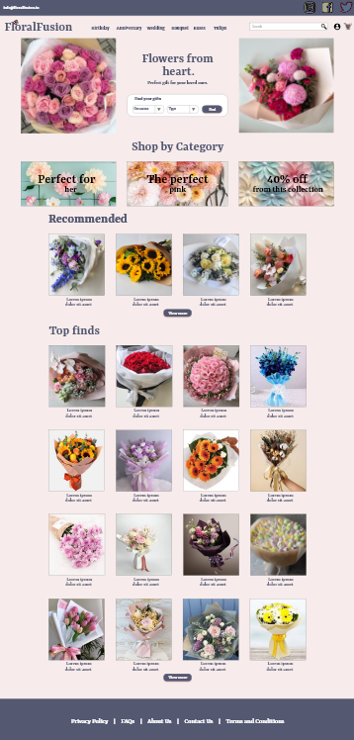
Project overview
The product:
FloralFusion is a florist’s webshop that offers hand-made bouquets for different occasions (birthday, engagement, wedding or any other). FloralFusion goal to make filtering and finding a bouquet easy for all types of users.
Project duration:
November 2023

Slide 3
Project overview
The problem:
Design a flower ordering flow for a florist.
The goal:
Design a flower ordering flow that is user-friendly, has many filtering options, provides clear navigation and a fast checkout process.

Slide 4
Project overview
My role:
UX designer leading the FloralFusion webpage design.
Responsibilities:
Conducting user research and
competitive audit, paper and digital wireframing, low and high-fidelity prototyping, conducting usability studies, accounting for accessibility, iterating on designs and making the design responsive.

Slide 5
User research
Personas
Problem statements
User journey maps
Understanding
the user

Slide 6
User research: summary
I conducted user research and a competitive audit to understand the target users. I made empathy maps based on research to better understand their needs. I discovered that many users need quick filtering by occasion categories to quickly find bouquets according to the purpose of gift giving. I have also discovered that they need some further alternative choices to the chosen bouquet helping the final decision.

Slide 7
User research: pain points
1
2
3
Filters
Interaction
Navigation
Shopping a bouquet comes from many purposes, that should be easily identifiable through quick filtering options.
Build trust with clear structure, obvious action buttons, and options to change anything at any point.
Users need to know where they are in the process but have an option to start over at any time.

Slide 8
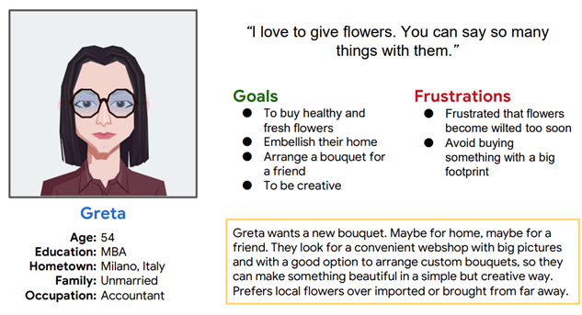
Persona: Greta
Problem statement:
Greta is a good friend who loves to give unique bouquets to their friends, who needs an option to find hand-made creations from flowers because they want to surprise and remind them how special their friends are.

Slide 9
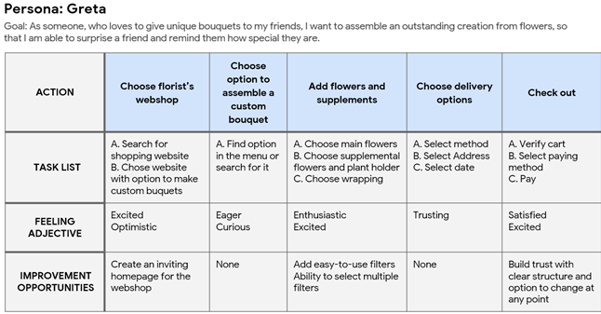
User journey map
I created a user journey map of Greta’s experience that revealed possible pain points and improvement opportunities.
Image of user journey map

Slide 10
Paper wireframes
Digital wireframes
Low-fidelity prototype
Usability studies
Starting
the design

Slide 11
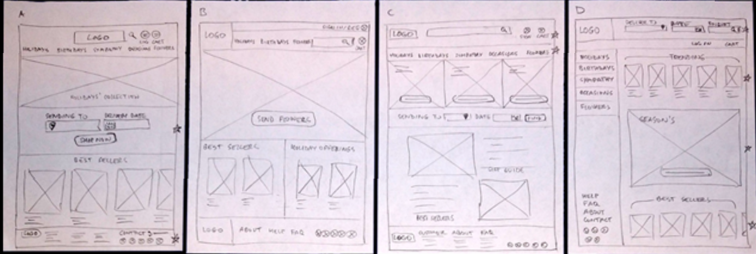
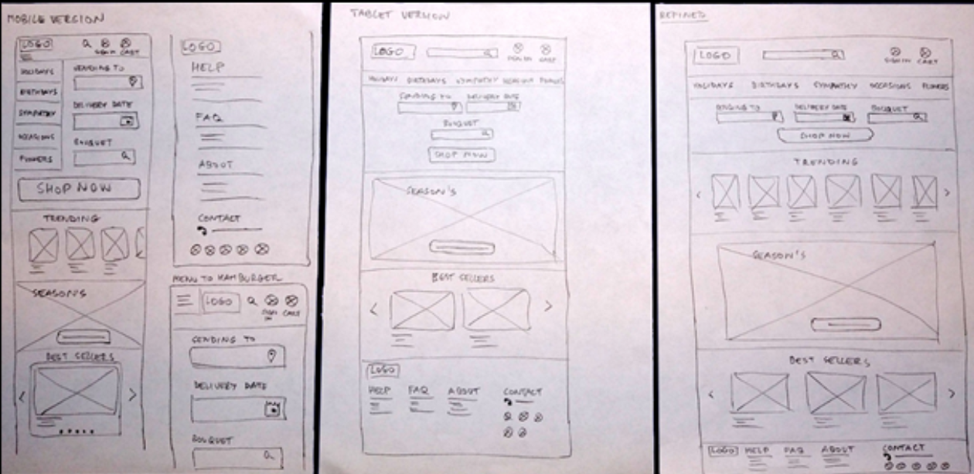
Paper wireframes
Next, I sketched out paper wireframes for each screen in the webshop, keeping the user pain points about filtering, navigation, and checkout flow in mind.
I also made variations for the home screen paper wireframe to the right focus on optimizing the browsing experience for users.
Image of paper wireframes including five different versions of the same screen and one image of the new, refined version

Slide 12
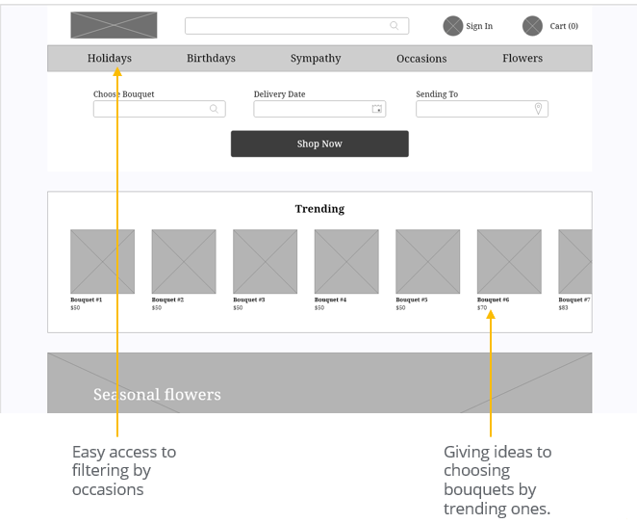
Digital wireframes
Moving from paper to digital wireframes made it easy to understand how the redesign could help address user pain points and improve the user experience.
Prioritizing filtering options in the menu itself, and visual element placement on the home page was a key part of my strategy.

Slide 13
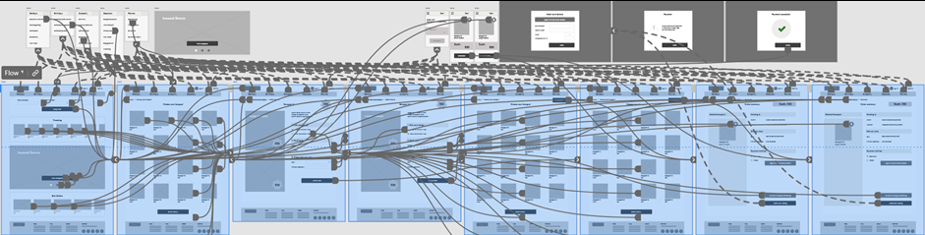
Low-fidelity prototype
To create a low-fidelity prototype, I have connected all of the screens involved in the primary user flow that contained adding an item to the cart and checking out.
At this point, I had conducted a usability study about things like placement of buttons and page organization. I implemented several suggestions in places that addressed the identified user pain points.
Screenshot of prototype with connections or prototype GIF

Slide 14
Usability study: findings
Study type: Moderated usability study, Locations: Online, Participants:
5 participants, Length: 15-20 minutes
Round 1 findings
Round 2 findings
Interface
The desktop layout needs a redesign with smaller texts and elements.
1
Need for Icon
The text-only approach for Sign-in and Cart was not enough for the users, they needed icons next to the texting as well
1
2
Feedback on Cart
Users needed further visual key when the cart contains an item.

Slide 15
Refining
the design
High-fidelity prototype
Accessibility

Slide 16
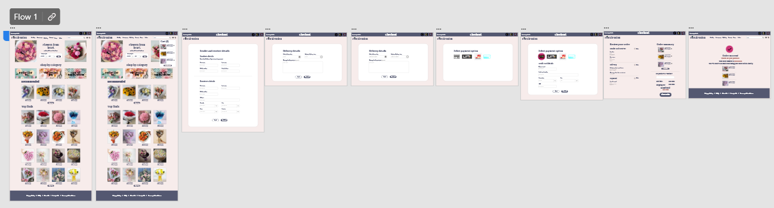
High-fidelity prototype
https://xd.adobe.com/view/88efa61a-0d15-4b9b-a41c-29c0e59d9106-ddbc/

Slide 17
Accessibility considerations
1
2
3
I used headings with enlarged sizes and medium weight text for clear visual hierarchy
Used alt texts available for every element to help screen reader access.
Used landmarks to help users who rely on assistive technologies to be able to traverse the site more easily.

Slide 18
Going forward
Takeaways
Next steps

Slide 19
Takeaways
Impact:
The target users in the usability of the hi-fi prototype shared that the design was intuitive to navigate, the many options for different occasions helped the ordering process to become quicker, and the changes of the text properties achieved a clearer visual hierarchy.
What I learned:
I learned that more user testing helps getting more insights on user needs and understanding of their pain points, and even the smallest changes can have a huge impact on user experience.

Slide 20
Next steps
1
2
Conduct follow-up usability testing on the released website.
Identify any additional areas of user needs and ideate on new features.

Slide 21
Insert a few sentences summarizing the next steps you would take with this project and why. Feel free to organize next steps in a bullet point list.
Let’s connect!
Thank you for your time reviewing my work on the FloralFusion app! If you’d like to see more or get in touch, my contact information is provided below.
Email: n.komal@iitg.ac.in
LinkedIn: https://www.linkedin.com/in/komalnirania

